Slide 1

SMART BRIDGE 2026 Internship project
PROJECT NAME: DOCSPOT: SEAMLESS APPOINTMENT BOOKING FOR HEALTH
TEAM ID: LTVIP2026TMIDS47812
team members:
Dandu Chandrika
Kommera Sujana
Kotte Hemalatha
Kodidela Maneesha
Mallam Bhavana
College Name: KLM COLLEGE OF ENGINEERING FOR WOMEN

Slide 2
Introduction
DocSpot is a digital healthcare appointment booking platform.
It connects patients with doctors easily.
Eliminates long waiting hours in hospitals.
Provides quick and convenient access to healthcare services.

Slide 3
Problem Statement
Long waiting times at hospitals.
Manual appointment booking process.
Lack of transparency in doctor availability.
Difficulty in emergency scheduling.

Slide 4
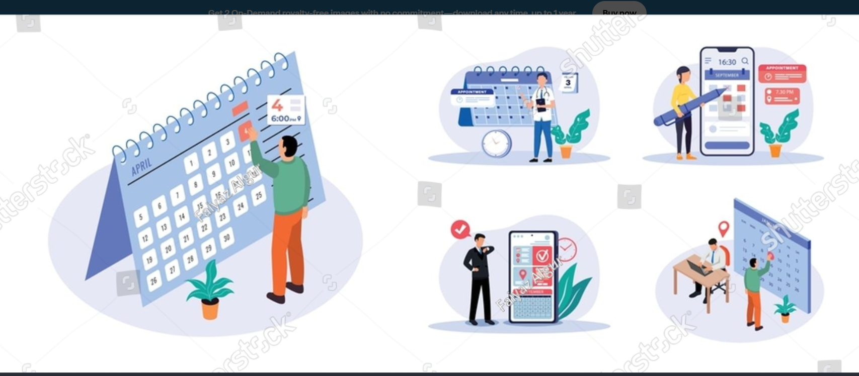
Proposed Solution
Online appointment booking system.
Real-time doctor availability updates.
Automated reminders via SMS/Email.
Secure patient data management.

Slide 5
Technologies Used
Frontend: HTML, CSS, JavaScript / React
Backend: Python (Flask/Django)
Database: MySQL / MongoDB
Cloud Hosting Support

Slide 6
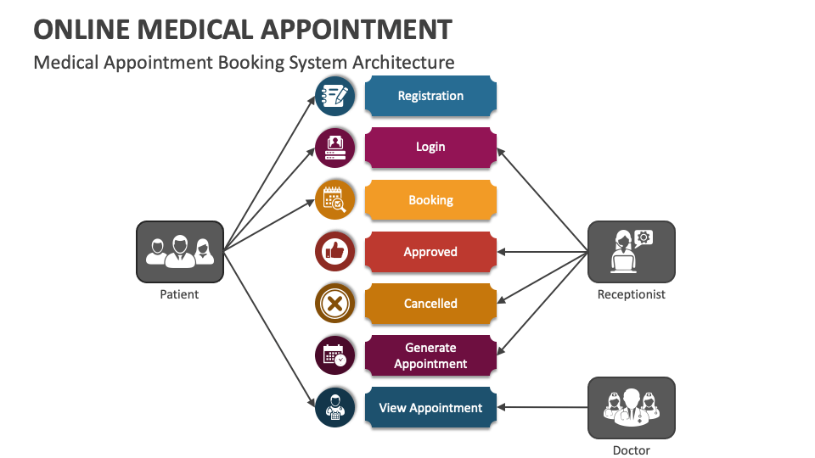
System Architecture
User Interface (Patient & Admin Panel)
Application Server
Database Server
Notification & Payment Gateway Integration

Slide 7
Key Features
User Registration & Login
Book, Cancel & Reschedule Appointments
Search Doctors by Specialty
Digital Prescription Storage
Payment Integration

Slide 8
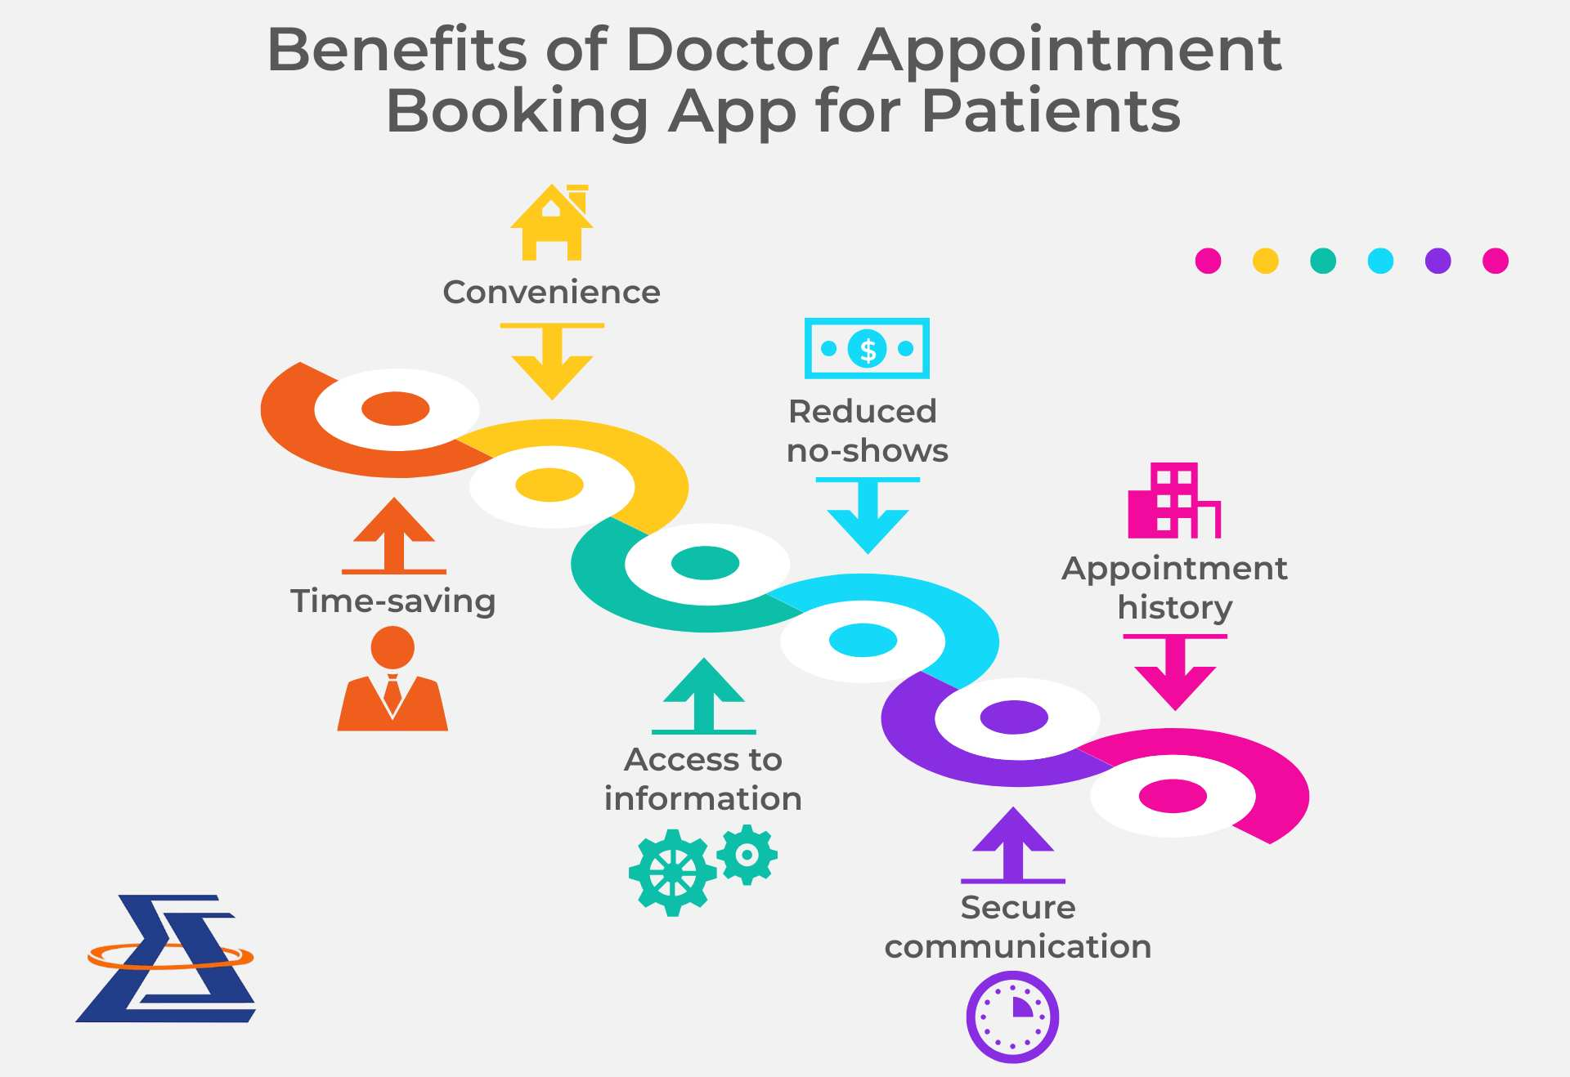
AdvantageS
Saves Time
Reduces Hospital Crowding
Improves Patient Experience
Easy Access to Medical Records

Slide 9
Future Scope
AI-based Doctor Recommendation
Video Consultation Feature
Mobile Application Development
Integration with Health Insurance Systems

Slide 10
Conclusion
DocSpot simplifies healthcare appointment booking by providing
a fast, secure, and user-friendly digital platform.
It enhances efficiency for both patients and healthcare providers.

